Slide 1

Data Science Forum: Survey Results
Lukas Ehlers
September 2018

Slide 2
Contents
About the Survey
Data Analytics Within Organisations
Members’ Familiarity with Data Science
Focus on Regular Data Science Users
Notes:
Welcome to this short introductions to Moodle. The objective of this presentation is to provide every student with a short but helpful overview of Moodle as well as to share some tips and tools on how to use Moodle and avoid unnecessary frustrations. Lastly we will provide some information on where to find additional help when you get stuck in Moodle!
This presentation will cover – What is Moodle?; How to log-on to Moodle; Moodle courses and structure and navigation in Moodle as well a short overview of some key Moodle functions that you may encounter in the course of your studies.

Slide 3
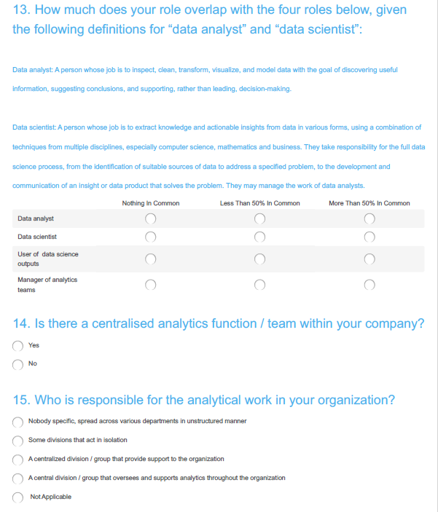
Main Aims of the Survey
Determine members familiarity with Data Science and related concepts.
Determine the extent to which Members Utilise Data Science Techniques.
Determine what data is available to members and to what extent it is used within organisations.
Identify the greatest barriers to more advanced analytics.
Identify trends from 2016 survey

Slide 4
Survey Structure
Employment Info
Data Science
Data
Demographic Information
Age
Qualification Stage
Job Level
Practice Area
Functions Performed
Job Overlap With
Data Scientist
Data Analyst
User of DS Output
Analytics Manager
Familiarity
Attributes
Attributes of Predictive Analytics
Attributes of Machine Learning
Benefit
Barriers to Entry
Education
Software
Techniques
External Sources
Accessibility
Storage
Usage
Employer Information
Company Type
Analytics Function
Attributes
Responsible Parties
Analytics Champion
Data Driven Decision Making
Current
Future
Notes:
Survey divided into four parts, asking questions about:
Demographic Information
Employment Information
Practice Areas
Functions Performed
Job Level
Employer Information
Analytics Function
Data Analytics Usage in Decision Making
Data Science
Attributes
Benefits
Techniques used
Data sources

Slide 5
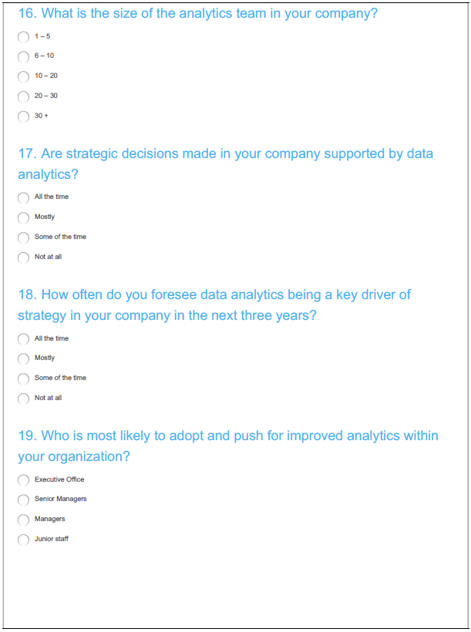
Basic Feedback
Similar to survey performed in October 2016
Distributed via Survey Monkey in August 2018
Awareness created through an email campaign via the Actuarial Society
Quick Facts
166 Respondents
  (down from 233 in 2016)

Slide 6
Demographic Overview
Practice Area Distribution
Company Type and Job Level Distribution
Notes:
Reasonable distribution across practice areas, with most respondents practicing in the Life Assurance field
For simplicity and credibility, going forward, the following groupings have been made: Long Term Fiels, Short Term Fiels and Other
Also worth noting that a reasonable distribution across organisation types, with the majority of respondents working for Risk Taking Entities
There’s a reasonable amount of individuals in each job level grouping
The percentage of respondents in the executive level does seem a bit high.

Slide 7
Employer Information
Analytics Function
Is there a centralised analytics function / team within your company?
Who is responsible for the analytical work in your organization?
Who is most likely to adopt and push for improved analytics within your organization?
Data Driven Decision Making
Are strategic decisions made in your company supported by data analytics?
How often do you foresee data analytics being a key driver of strategy in your company in the next three years?
What is the size of the analytics team in your company?
Data
Do you have direct access to the data at your employer?
What percentage of your data is on your employer’s internal system?
Do you make use of any of the following external data sources?
What percentage of the data in your company is used for analytics?
Notes:
First section covers the analytics landscape within employers, specifically:
The structure of the analytics function
The extent that analytics influences strategy
And the sources of data and to what extent it is used

Slide 8
Company Analytics Structure
Size of the Analytics Team
Who is most likely to adopt and push for improved analytics within your organization?
Notes:
First graph:
Clear that Life Assurance / Pensions have no / smaller analytics teams than the other areas.
The non-life / pensions areas are more likely to have larger analytics teams, with more than 30% of respondents having an analytics team larger than 10 people.
Second Graph
Senior management and executives are generally believed to adopt and push for increased analytics.
Interestingly, the overwhelming majority of executives’ believe that they are responsible, while senior managers’ responses are more evenly distributed between the executive and themselves

Slide 9
Data Availability and Utilisation
Percentage of Data Accessible on Internal Systems
Utilisation of Available Data
Notes:
Only 20% of respondents have access to less than 50% of data.
However, only 56% has access to more than 75%
Second graph:
Generally, individuals will utilise a larger percentage of the data that is available as more data becomes available.
Could be, due to individuals with less data having a lower need for analytics, insufficient staffing, or no infrastructure for analytics
However, most individuals only use between 25% - 75%
Could be the data is not relevant, but there is room for companies to use the unused data to their advantage.

Slide 10
Data Sources
Internal Data Sources
External Data Sources
Notes:
CSV rules supreme, then traditional databases.
50% of responders are still making use of access databases
For those who use both, it’s worth asking why both is used, and why isn’t everything done on traditional DB’s?
Fairly low utilisation of big data solutions, interestingly there’s a significant proportion of respondents’ that don’t see a need in using it.
Non-Life and Non-Short term entities are most likely to use external data sources, but generally, the utilisation is still fairly low.

Slide 11
Data Driven Decision Making
Are strategic decisions made in your company supported by data analytics?
Distribution of Future Usage of Data Analytics to make strategic decisions
Notes:
Currently, the majority of respondents stated that analytics are only used some of the time to support strategic decisions, with a steep drop off in frequency.
However, this position is expected to change to mostly in the future, however, there is also a big increase in respondents stating that strategic decisions will be supported all the time by analytics.
Looking at the distribution of the changes, by current usage:
Individuals who don’t use analytics will use it some of the time
Overall, others respondents will maintain or increase the utilisation of analytics, very unlikely to decrease analytics usage.

Slide 12
Data Driven Decision Making
Distribution of Future Usage of Data Analytics to make strategic decisions 2018
Distribution of Future Usage of Data Analytics to make strategic decisions 2016
Notes:
Currently, the majority of respondents stated that analytics are only used some of the time to support strategic decisions, with a steep drop off in frequency.
However, this position is expected to change to mostly in the future, however, there is also a big increase in respondents stating that strategic decisions will be supported all the time by analytics.
Looking at the distribution of the changes, by current usage:
Individuals who don’t use analytics will use it some of the time
Overall, others respondents will maintain or increase the utilisation of analytics, very unlikely to decrease analytics usage.

Slide 13
Data Driven Decision Making
Strategic Decision Making Supported by Data by size of analytics team
Strategic Decision Making Supported between industries
Notes:
First Graph:
All individuals who have stated that analytics is never used to support strategic decisions have no analytics team, or a team with less than 5 people.
Generally, the bigger the team, the more decisions will be supported by analytics
The trend seems to stabilise once the analytics team is greater than 10 members.
Second Graph:
Life / Pensions seem to be less reliant on data analytics than other fields
Other fields are equally likely to make decisions based on analytics some of the time / mostly

Slide 14
Familiarity and Overlap With Data Science
Data analyst: A person whose job is to inspect, clean, transform, visualize, and model data with the goal of discovering useful information, suggesting conclusions, and supporting, rather than leading, decision-making.
Data scientist: “A person whose job is to extract knowledge and actionable insights from data in various forms, using a combination of techniques from multiple disciplines, especially computer science, mathematics and business.
They take responsibility for the full data science process, from the identification of suitable sources of data to address a specified problem, to the development and communication of an insight or data product that solves the problem. They may manage the work of data analysts.”
Which of the following functions do you perform in your current role?
How would you best describe your familiarity with the data science universe?
The most important benefits of data analytics
What is the greatest barrier to doing more advanced analytics?
Please indicate whether you or your team use any of the data science techniques for actuarial purposes
How much does your role overlap with the four roles below, given the following definitions for “data analyst” and “data scientist”:
Notes:
Next section focusses on the individual members, specifically, at:
To what extend do respondents actually use data science techniques and perform the related functions
And how familiar they said they are with data science
Also cover: the benefits and the barriers of advanced analytics

Slide 15
Data Science Familiarity and Actual Usage
Notes:
Majority (54%) of respondents said that they haven’t used any data science techniques or technologies. However, looking at the graph on the right, based on the techniques that they said they used at least occasionally, this is not the case.
Majority of respondents have stated that they’re job overlaps to some extent with that of a data analyst.
So, the overlap is significant, but the awareness is lacking.

Slide 16
Familiarity: Techniques Used
Technique Utilisation Over Time
Familiarity by Users of Techniques
Notes:
Data visualisation and regression models are the most frequently used,
Life insurance / Pensions don’t use the techniques widely
Interestingly, users of these techniques are not aware that they are using techniques associated with data science

Slide 17
Familiarity: Functions Performed
Roles Performed by Respondents
Familiarity by Individuals Performing Functions
 | Life Assurance / Pensions | General Insurance / Health Care | Other
Management Reporting | 52% | 56% | 31%
Programming / Development | 41% | 46% | 44%
Predictive Modelling | 28% | 51% | 47%
Business Intelligence | 25% | 54% | 37%
Pricing | 39% | 52% | 31%
Product Development | 42% | 38% | 39%
Risk Management | 31% | 32% | 39%
Reserving | 37% | 33% | 20%
Business Development | 25% | 38% | 28%
Operational Modelling | 24% | 22% | 27%
Other | 20% | 16% | 28%
Marketing | 19% | 19% | 16%
Telematics | 1% | 13% | 3%
Notes:
Life insurance have a more uniform distribution of individuals performing functions.
Possibly, individuals working in this space are more focussed on specific functions.
However, a very small number of individuals are performing predictive modelling in this space.
Again, various individuals performing functions related to data science are not aware of this.

Slide 18
Benefits of Data Analytics
The most important benefits of data analytics
Importance Over Time

Slide 19
The Most Important Benefit of Data Analytics
The Most Important Benefit by Industry
Distribution of the Most Important Benefit by Job Level
Notes:
Very similar trends are seen across different practice areas, however, the General and Healthcare industry sees Greater Insight into data as the biggest benefit.
The higher a respondent’s job level the more likely they are to see Improved customer value and enhanced financial performance as the biggest benefits of data analytics. However, this is at the expense of greater insights into data.

Slide 20
Barriers to More Advanced Analytics
What is the greatest barrier to doing more advanced analytics?
Greatest Barrier by Current Usage of Data Analytics to Make Strategic Decisions
Notes:
Shortage of skill is seen to be the greatest barrier to advanced analytics, followed by lack of perceived need from management.
An interesting trend emerges when looking at the extent that analytics is used to make strategic decisions:
The more frequent analytics is used the more likely that the biggest barrier is seen as shortage of staff, but the less likely it seems that there is no need from management.

Slide 21
Attributes of regular users of data science
“I regularly use data science techniques in the production of my actuarial findings.”

Slide 22
Regular Users: Data Driven Decision Making
Are strategic decisions made in your company supported by data analytics?
How often do you foresee data analytics being a key driver of strategy in your company in the next three years?
Notes:
Much more likely to work for companies that are currently using analytics to support strategic decisions.
Fairly uniformly distributed between some of the time, mostly and all the time.
Likely to change to mostly and all the time.
Non-users are likely to be equally distributed between some of the time and mostly.

Slide 23
Regular Users: Data Sources and Software
Please provide information on what data sources you are currently using or would like use or why you are not using the source.
What software do you make use of to do analytics?
Notes:
CSV’s are still king
Lower utilisation of Access databases
Majority of users have access to traditional databases
However, split on big data solutions: 30% don’t need to use it, 35% want to use it and 36% are currently using it.
In terms of software: Excel and R are the most used, however, relative use of other free / readily available software.

Slide 24
Regular Users: Techniques Used
Please indicate whether you or your team use any of the data science techniques for actuarial purposes.
Notes:
Similar trends of techniques used as the general sample.
Interesting to note that the simple techniques are the most frequently used, even though the users are familiar with more advanced techniques.

Slide 25






Regular Users: Education
Which of the following methods have you used in order to find out more about data science or big data?
Notes:
Online First and Classrooms are last

Slide 26
Summary
Aims of the Survey | Result
Determine members familiarity with Data Science and related concepts. | Small proportion of respondents are not familiar with Data Science, while 40% describe themselves as using the techniques at least occasionally.
Determine the extent to which Members Utilise Data Science Techniques. | 76% of respondents regularly use Data Science Techniques. Respondents working in General Insurance / Healthcare or non-Insurance entities are more likely to use the techniques
Determine to what data is available and to what extent it is used within organisations | Most respondents stated that data analytics is only used some of the time to support strategic decisions currently, the majority stated that it will be used mostly, but not all the time in the future. 26% of respondents utilise Big Data Solutions, but CSV’s and Traditional Databases are the most popular.
Determine the greatest barriers to more advanced analytics | Shortage of Skilled Staff was listed as the greatest barrier, with a lack of system infrastructure that supports analytics being the second largest barrier.
Identify trends from 2016 survey | Respondents showed an increase in their general awareness in analytics. Increases have also been observed in the “entry-level” techniques.

Slide 27

Thank You & Questions
Lukas Ehlers
Senior Manager
Deloitte Actuarial and Insurance Solutions
lehlers@deloitte.co.za

